Slide 1
Speed Control of DC Motors

Slide 2
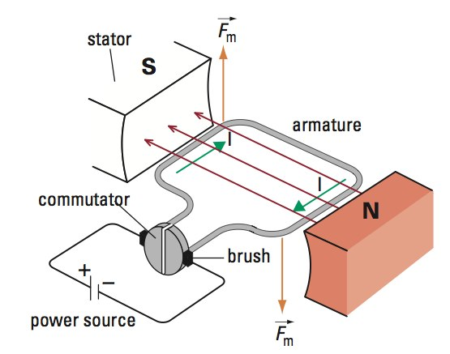
https://electronics.stackexchange.com/questions/452474/self-inductance-in-steady-state-equivalent-model-of-brushed-dc-machine

Slide 3
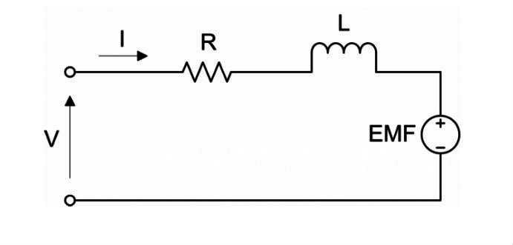
https://www.precisionmicrodrives.com/content/dc-motor-speed-voltage-and-torque-relationships/
Derive formula

Slide 4
Maybe just use circuit w/o inductor

